Slide 1
SYSTEM PRESENTATION GROUP-5

Slide 2
SYSTEM NAME
CONTACT MANAGEMENT SYSTEM

Slide 3
CONTACT MANAGEMENT SYSTEM (CMS)
Overview This system allows users to add, show, and delete contact. Contacts are stored in a text file called “contactdata.txt”. The program uses a switch statement to allow users to choose between the different functions. The program uses functions such as “system” and “fstream” to perform operations on the console
and file system.

Slide 4

DOES IT ACTUALLY WORK?
LET’S FIND OUT
The program uses a switch statement to determine which option the user has chosen, and then executes the corresponding code.
Here are the details of each case:

Slide 5
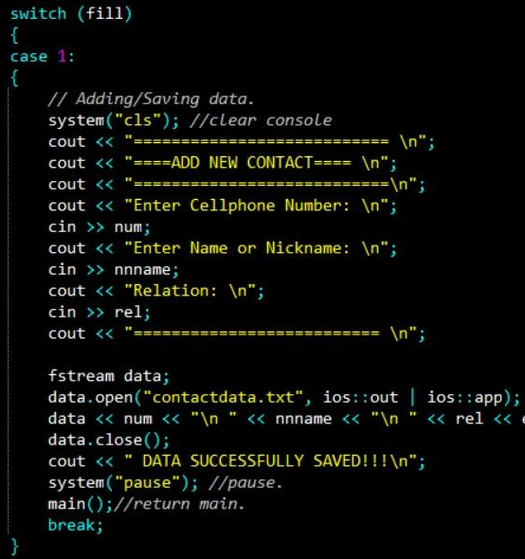
This case allows the user to add a new contact to the system. The program prompts the user to enter the contact's cellphone number, name or nickname, and relation. It then opens a file called "contactdata.txt" in append mode, writes the contact's information to the file, and closes the file. The program then displays a message indicating that the data has been saved and prompts the user to press any key to continue. Finally, the program calls the main() function recursively to return to the main menu.

Slide 6
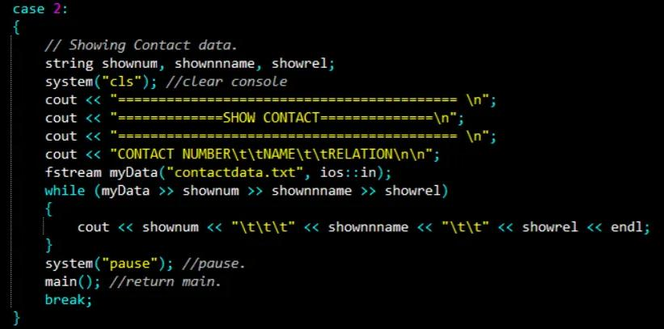
This case displays all the contacts stored in the "contactdata.txt" file. It opens the file in input mode, reads each line of the file, and prints the contact's cellphone number, name or nickname, and relation to the console. After all contacts have been displayed, the program prompts the user to press any key to continue, clears the console, and then calls the main() function recursively to return to the main menu.

Slide 7
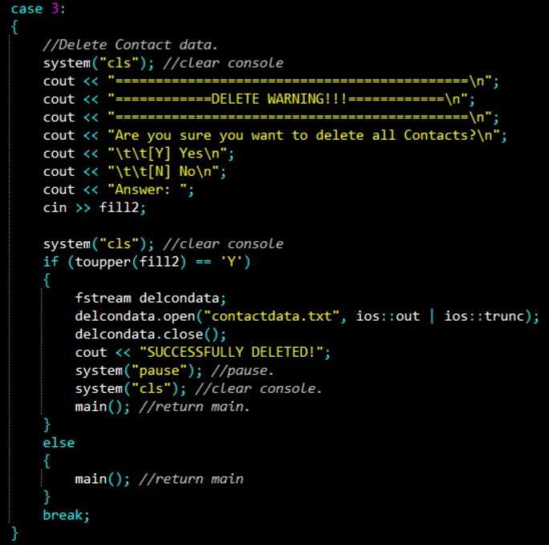
This case allows the user to delete all contacts stored in the “contactdata.txt” file. The program displays a warning message asking the user to confirm the deletion. If the user enters ‘Y’, the program opens the file in truncate mode, which deletes all the contents of the file. The program then displays a message indicating that the contacts have been deleted, prompts the user to press any key to continue, clears the console, and calls the main() function recursively to return to the main menu. If the user enters ‘N’, the program simply returns to the main menu.

Slide 8
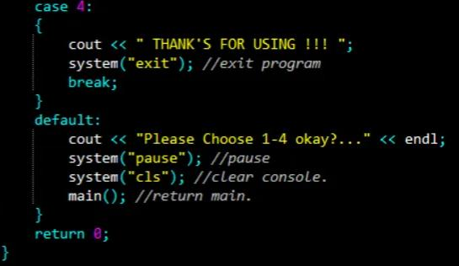
Exiting the Program Users can exit the program by selecting option 4 from the main menu The program displays a message thanking the user for using the program The program then exits using the “exit” function

Slide 9
CONCLUSIONS
This program demonstrates basic file I/O and switch statement usage in C++ This program can be extended to include additional functionality, such as editing or searching for contacts

Slide 10
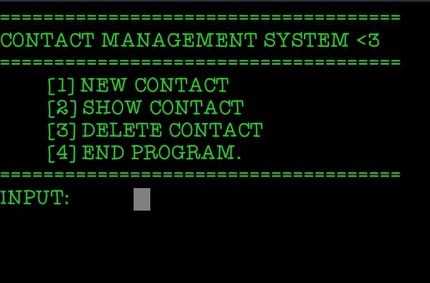
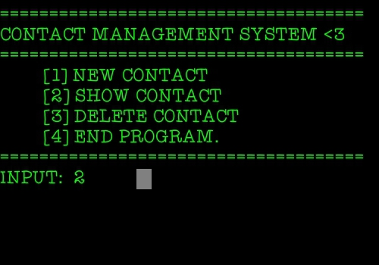
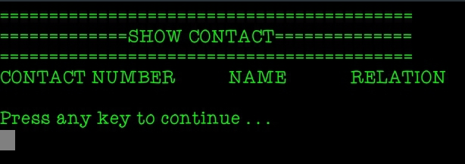

Slide 11
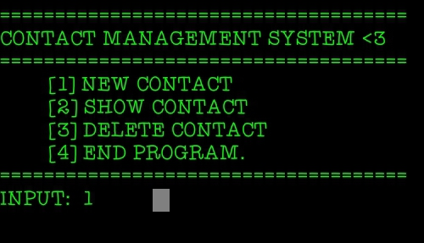
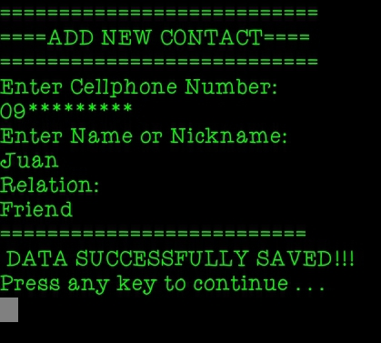
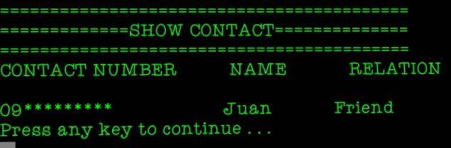

Slide 12
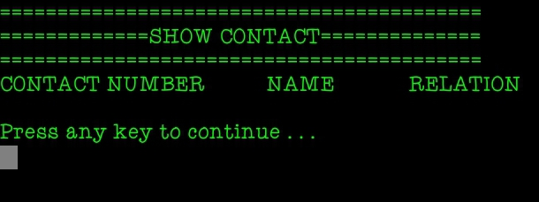
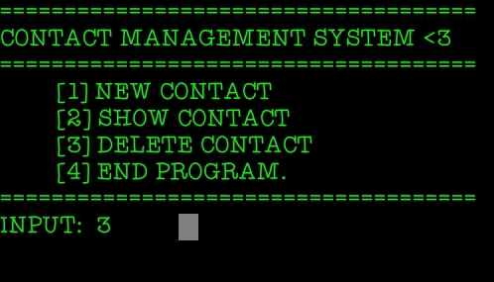
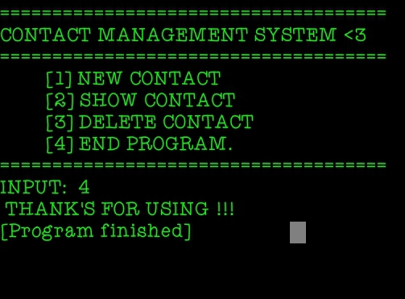
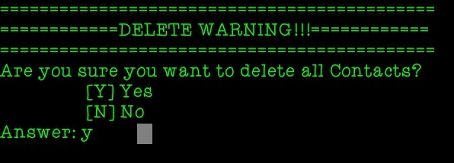

Slide 13
Cout <<“That’s All Thankyou <3”;

